Slide 1
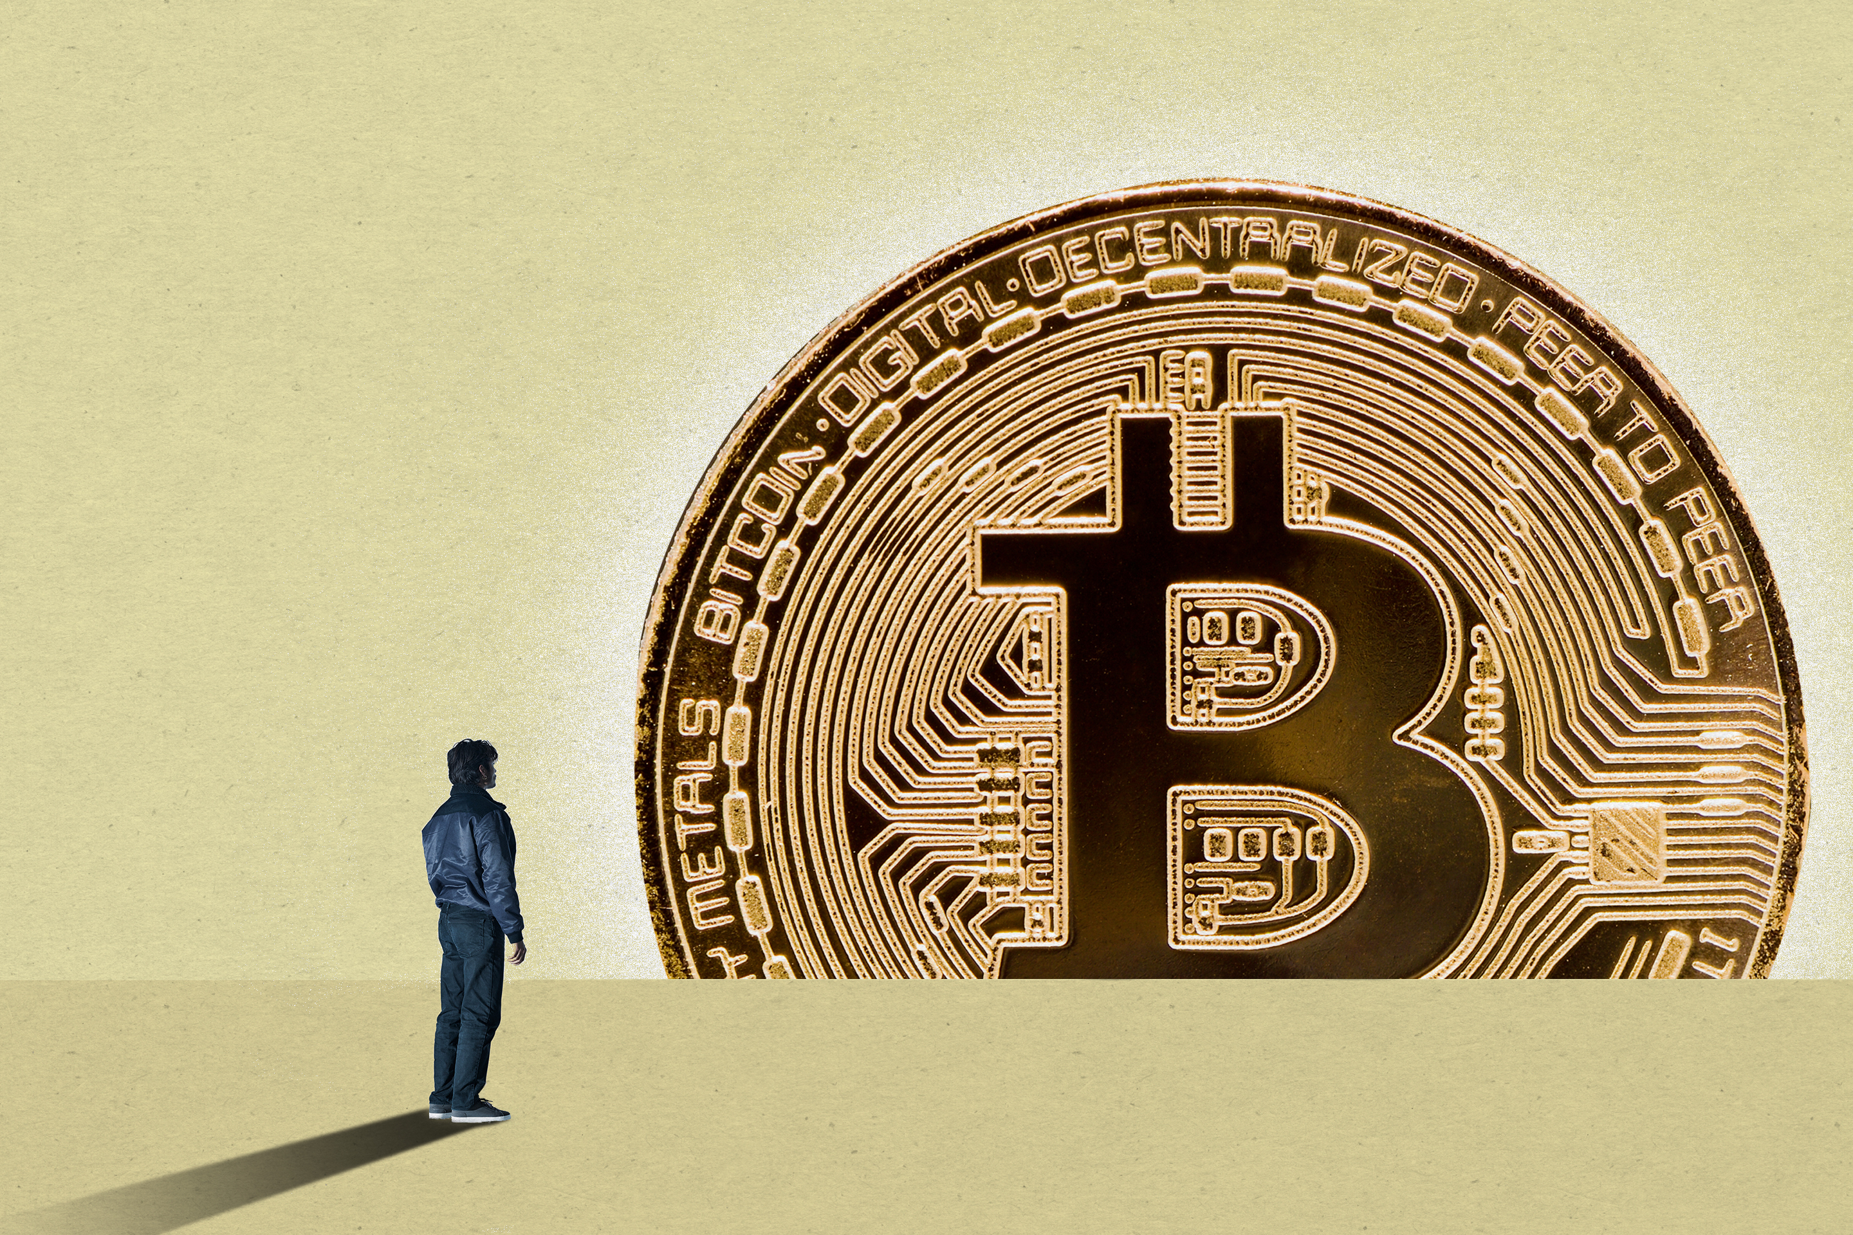
Demystifying Bitcoin -nuts and bolts
Dr. Taha Ali
(NUST-SEECS)

Slide 2

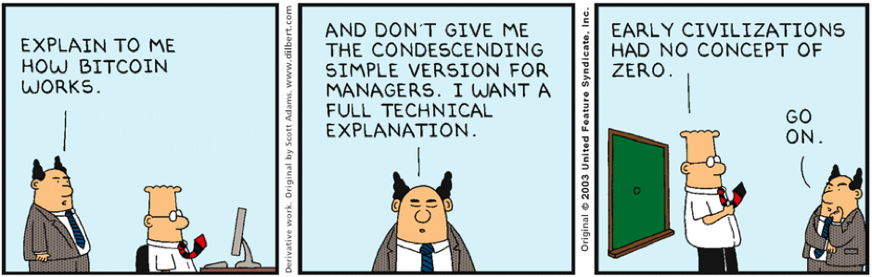
overview
0
how Bitcoin works
Bitcoin mania

Slide 3
overview
1
digital payments system vs. cryptocurrency
Satoshi Nakamoto
Ethereum, Litecoin, Zerocash, Ripple, Cardano, etc.
trillion dollar ecosystem
best asset class of the decade (gains>20 million percent!)
Notes:
-cryptocurrency vs. digital payments system?
-This digital currency that started off as a ragtag underground anarchist experiment was at parity with the US dollar in 2011. This month a bitcoin was briefly worth over 19,000 dollars.
-Pakistani economy valued at 300 billion dollars

Slide 4
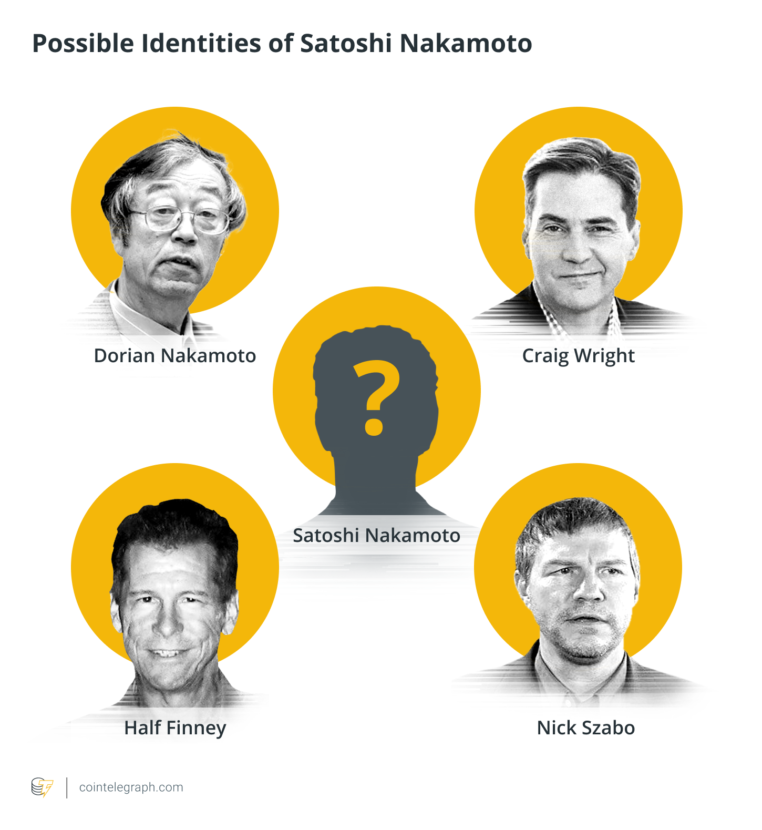
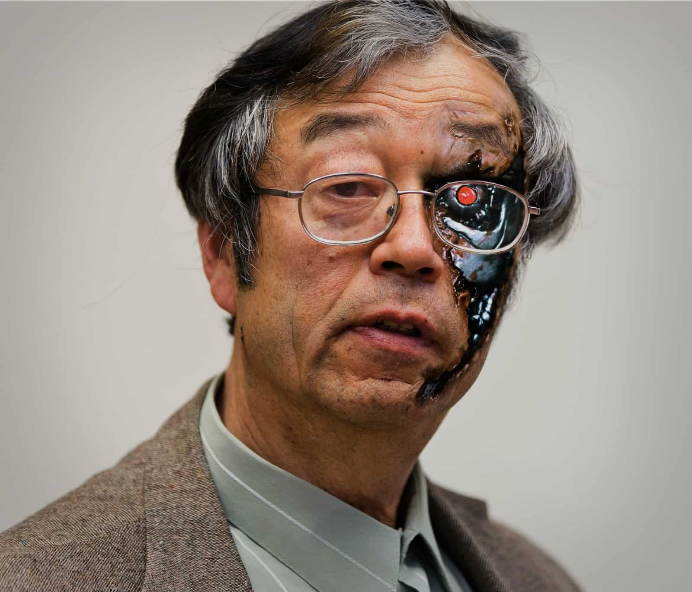

Satoshi Nakamoto
1

Slide 5
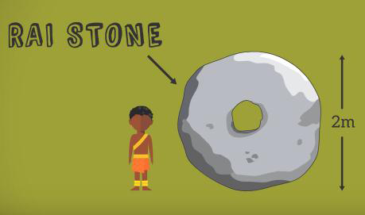


reimagining money
2
Notes:
-different payments systems paradigms 1. card paradigm (centralized database)
2. cash paradigm (unique tokens)
3. hybrid (Paypal)
-all these systems are centralized

Slide 6
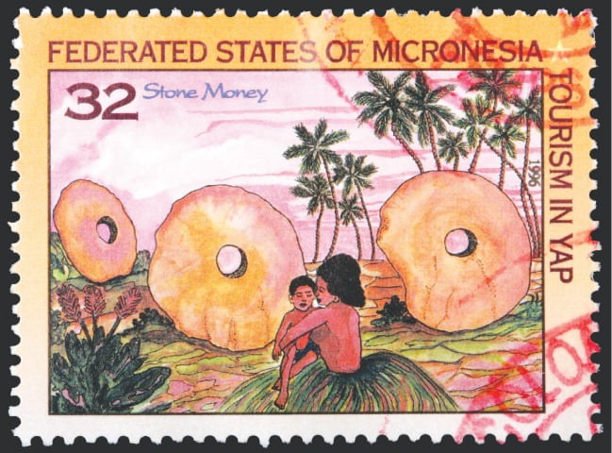


pretty pictures

Slide 7
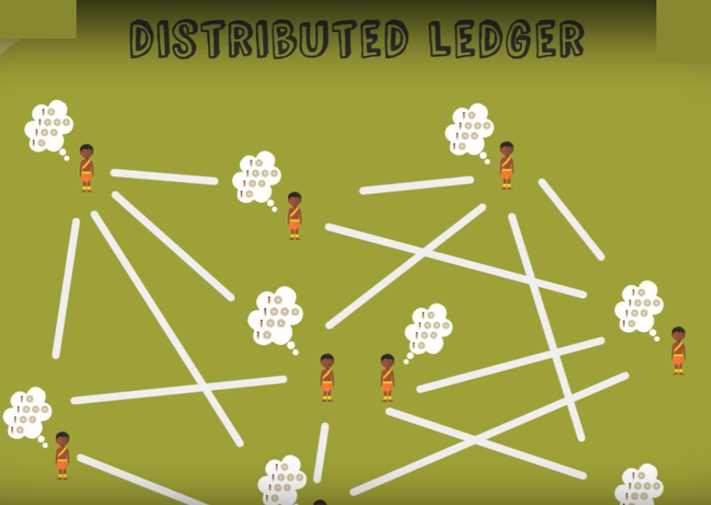
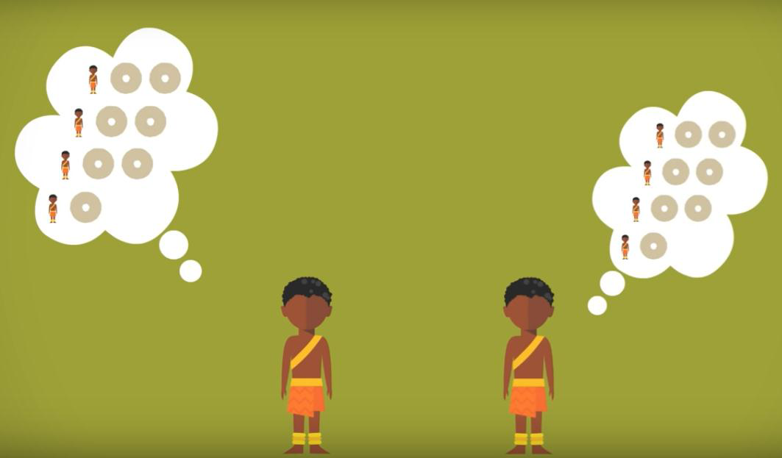

reimagining money
2
Notes:
-different payments systems paradigms 1. card paradigm (centralized database)
2. cash paradigm (unique tokens)
3. hybrid (Paypal)
-all these systems are centralized

Slide 8

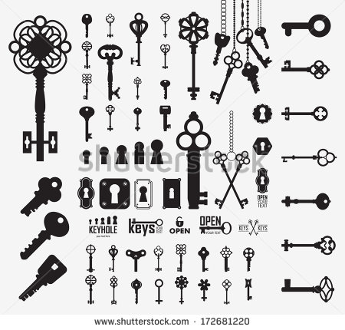


primitives: encryption
3
symmetric encryption – shared key
DATA
x1@f
DATA
asymmetric encryption – public key, private key
DATA
Zc7*
DATA

Slide 9


primitives: signatures
4
hash function – one way function
DATA
H()
1010
fixed length, unique and irreversible
easy to verify, computationally impossible to hack
‘digital signature’
Zc7*
DATA
H()
1010
COMPARE
Zc7*
1010

Slide 10
a Bitcoin transaction
6
public key = user address , private key = control of address
e.g. Alice wants to send Bob 5 bitcoins
Bob wants to send money to Charlie and Dave
transaction ID (9382)
input: Alice’s public key
output: Bob’s public key
amount: 5 BTC
Alice’s signature
transaction ID (5897)
input: Bob’s public key
transaction ref.: 9382
output: Charlie’s public key
amount: 1 BTC
output: Dave’s public key
amount: 4 BTC
Bob’s signature

Slide 11

mining
7
miners
block, blockchain
lottery – proof of work
difficulty level
BLOCK
RND
H()
00……
circulate
incentive
difficulty level moderated by protocol

Slide 12
properties
8
decentralized
double-spend protection
anonymity
efficient
secure
anonymity may be broken
difficult to use
no mechanisms for theft/fraud protection

Slide 13
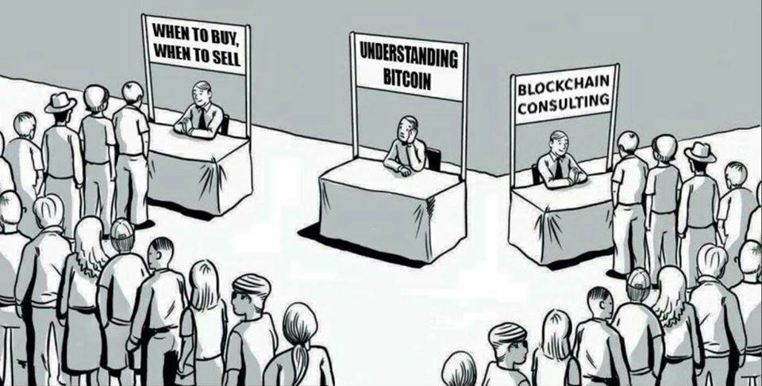
conclusion
9

Slide 14
references
9
Bitcoin: A Peer to Peer Electronic Cash System Satoshi Nakamoto
Foreword: The Long Road to Bitcoin Jeremy Clark, Bitcoin and Cryptocurrency Technologies
The Rise of Cryptocurrency Taha Ali DAWN, Oct, 2021

